Slide 1

William Roberts
Task8

Slide 2
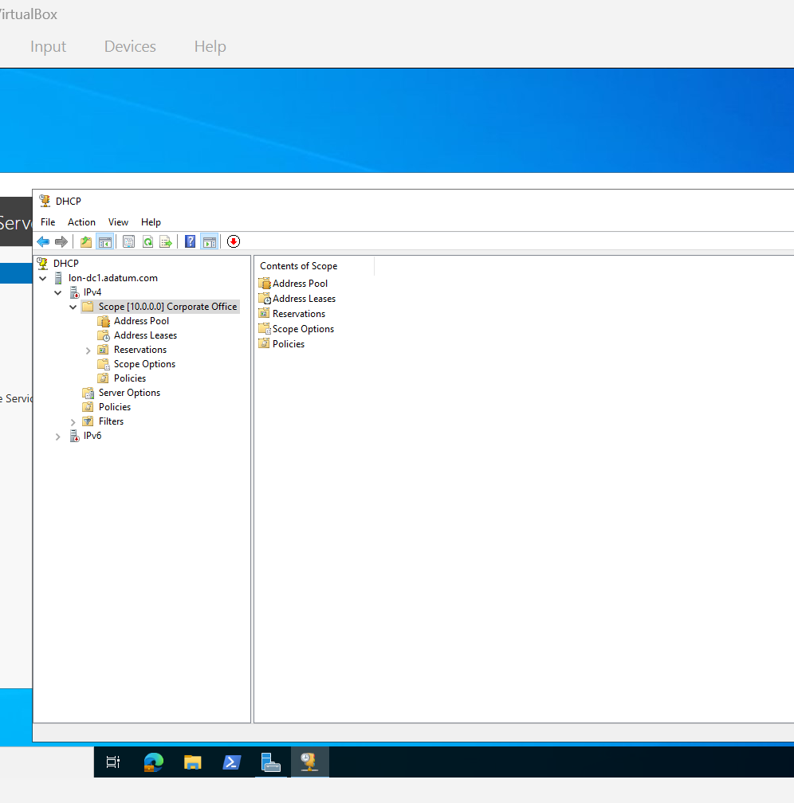
DHCP IPv4
Named Corporate Office
Gave IP address
Gave Subnet

Slide 3
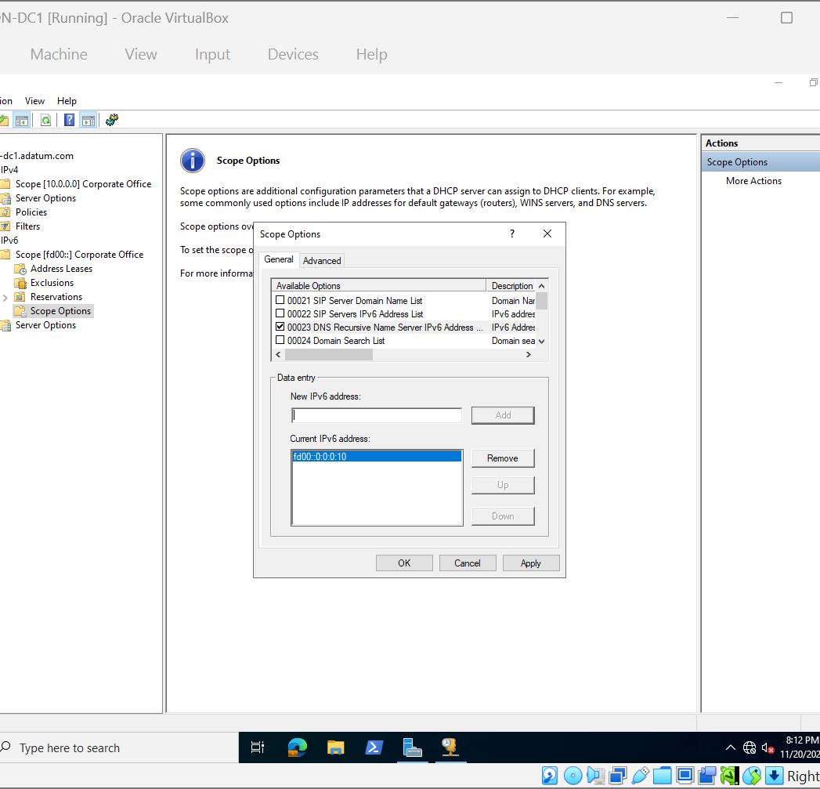
IPv6
Here I added IPv6 scope
Named Corporate Office
Gave IP address
Configured scope

Slide 4
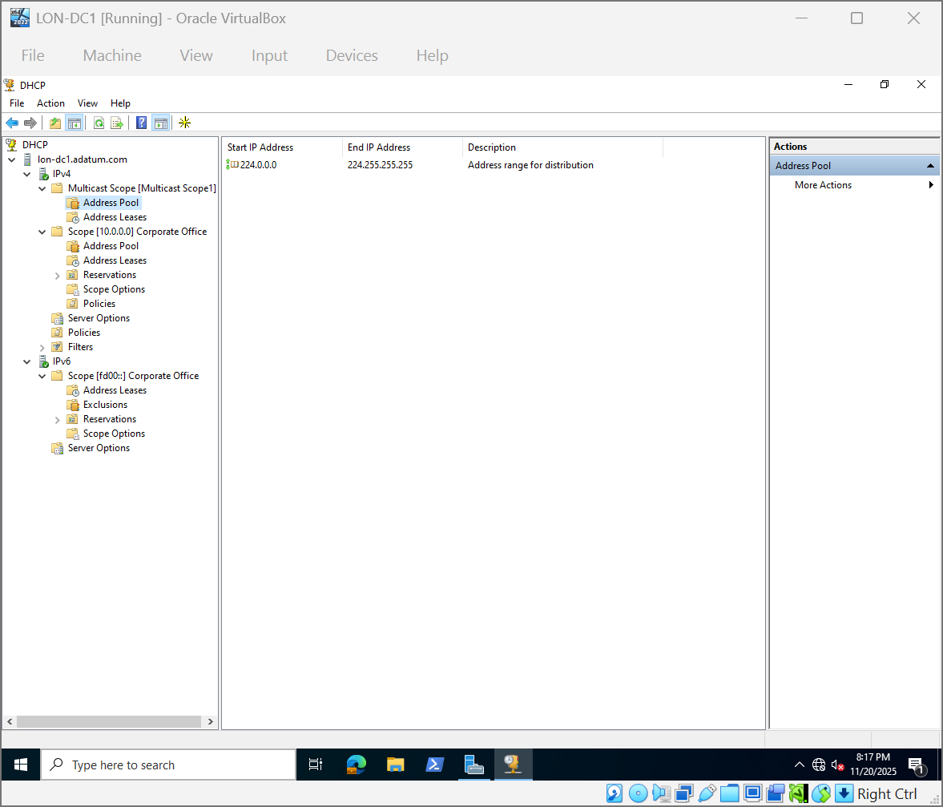
IPv4 Multicast Scope
Assigned IP address range

Slide 5
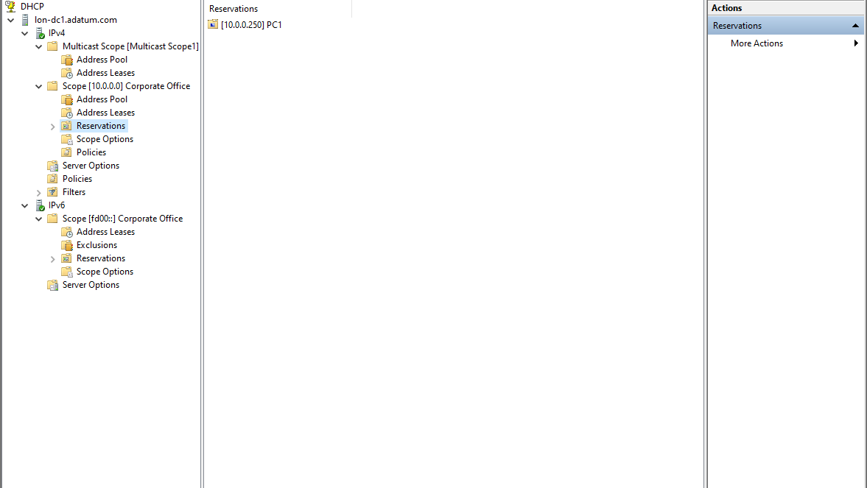
New Reservation
Added and named reservation with IP address

